Slide 1
Video and Audio Calling Web Application
ECM2001 Data Communications and Networks
J Component Review 3
Team Genisys
19BLC1037 Shivansh
19BLC1046 Pratyush Motha
Faculty:
Dr. Jayavignesh

Slide 2
Abstract
We have built a video calling application, the application is similar to google meet or zoom. Just like google meet or zoom, the users can generate a unique meeting id and share it with other people to join the video meeting together. The application uses an open source library called webRTC for real time audio video transmission from one node to another node. For this real time communication to take place there is a peer id, which needs to be shared with all participants of the meeting that the new user wants to join.

Slide 3
Continued...
This could be done through various different approaches but the modern and efficient one is using web sockets. The whole idea is to transfer the peer id of a node to others nodes using web sockets which will happen over the private server that we will own. To implement this operation we have Socket.IO, which is also an open source library. Now we also need to build a user interface and power the backend server for the application. For this purpose we have used React.Js which is also an open source UI manipulation library provided by Facebook. React makes it really easy to implement the UI part using Javascript as the primary programming language because it works on the principle of components which are reusable, so it prevents developers from writing the same code again and again. To power the server for the application, over which the unique meeting id generation and passing the peer id will take place.

Slide 4
Introduction
To build the application we have used WebRTC and Socket.io for real time communication purposes. WebRTC is a free and open-source project providing web browsers and mobile applications with real-time communication via simple application programming interfaces. WebRTC also provides several APIs that make it easy to contact browsers to get access to microphone, camera and several other output devices. Socket.IO is a JavaScript library for realtime web applications. It enables real-time, bi-directional communication between web clients and servers. It has two parts: a client-side library that runs in the browser, and a server-side library for Node.js. Both components have a nearly identical API.

Slide 5
Tech. Stack
WebRTC for real time audio video communication
React.JS for making web frontend
Node.JS to power backend
Socket.io for real-time communication (passing signals)
Browser APIs to access web camera and microphone

Slide 6
Reason Behind using the Tech. Stack
Unlike all other browser communication which use Transmission Control Protocol (TCP), WebRTC transports its data over User Datagram Protocol (UDP). The requirement for timeliness over reliability is the primary reason why the UDP protocol is a preferred transport for delivery of real-time data.
Socket.IO primarily uses the WebSocket protocol with polling as a fallback option, while providing the same interface. Although it can be used as simply a wrapper for WebSocket, it provides many more features, including broadcasting to multiple sockets, storing data associated with each client, and asynchronous I/O.

Slide 7
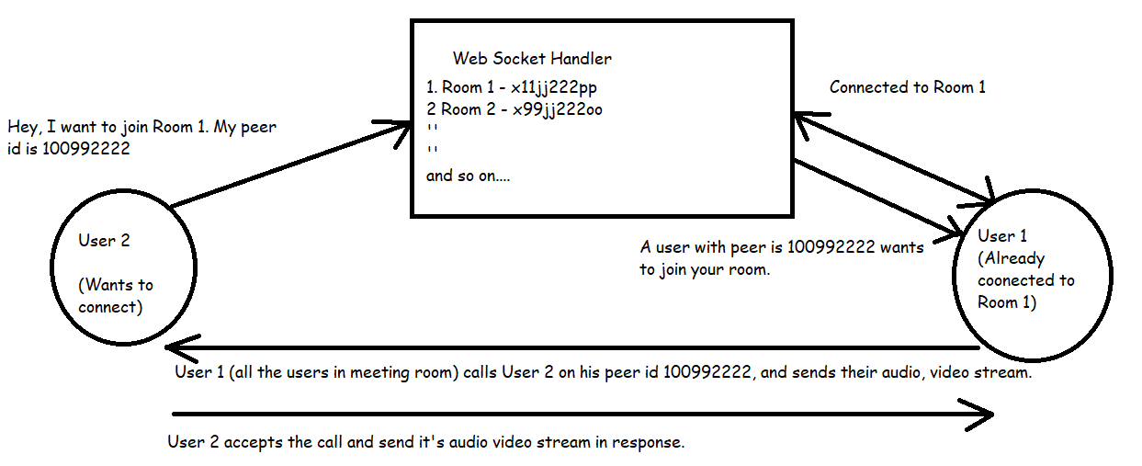
ALGORITHM

Slide 8
ALGORITHM STEPS:
Web Socket handler manages rooms, where the events are broadcasted as per requirement.
To simulate it's working, let's assume that User 1, User 2 and User 3 are already connected in Room 1.
Whenever some new user (User 5) requests the web socket handler to join Room 1, it will broadcast an event (data: <-peer-id-of-User-5->) in Room 1 stating that User 5 wants to join.
Then all the users will call User 5 individually, establishing a peer-2-peer connection.

Slide 9
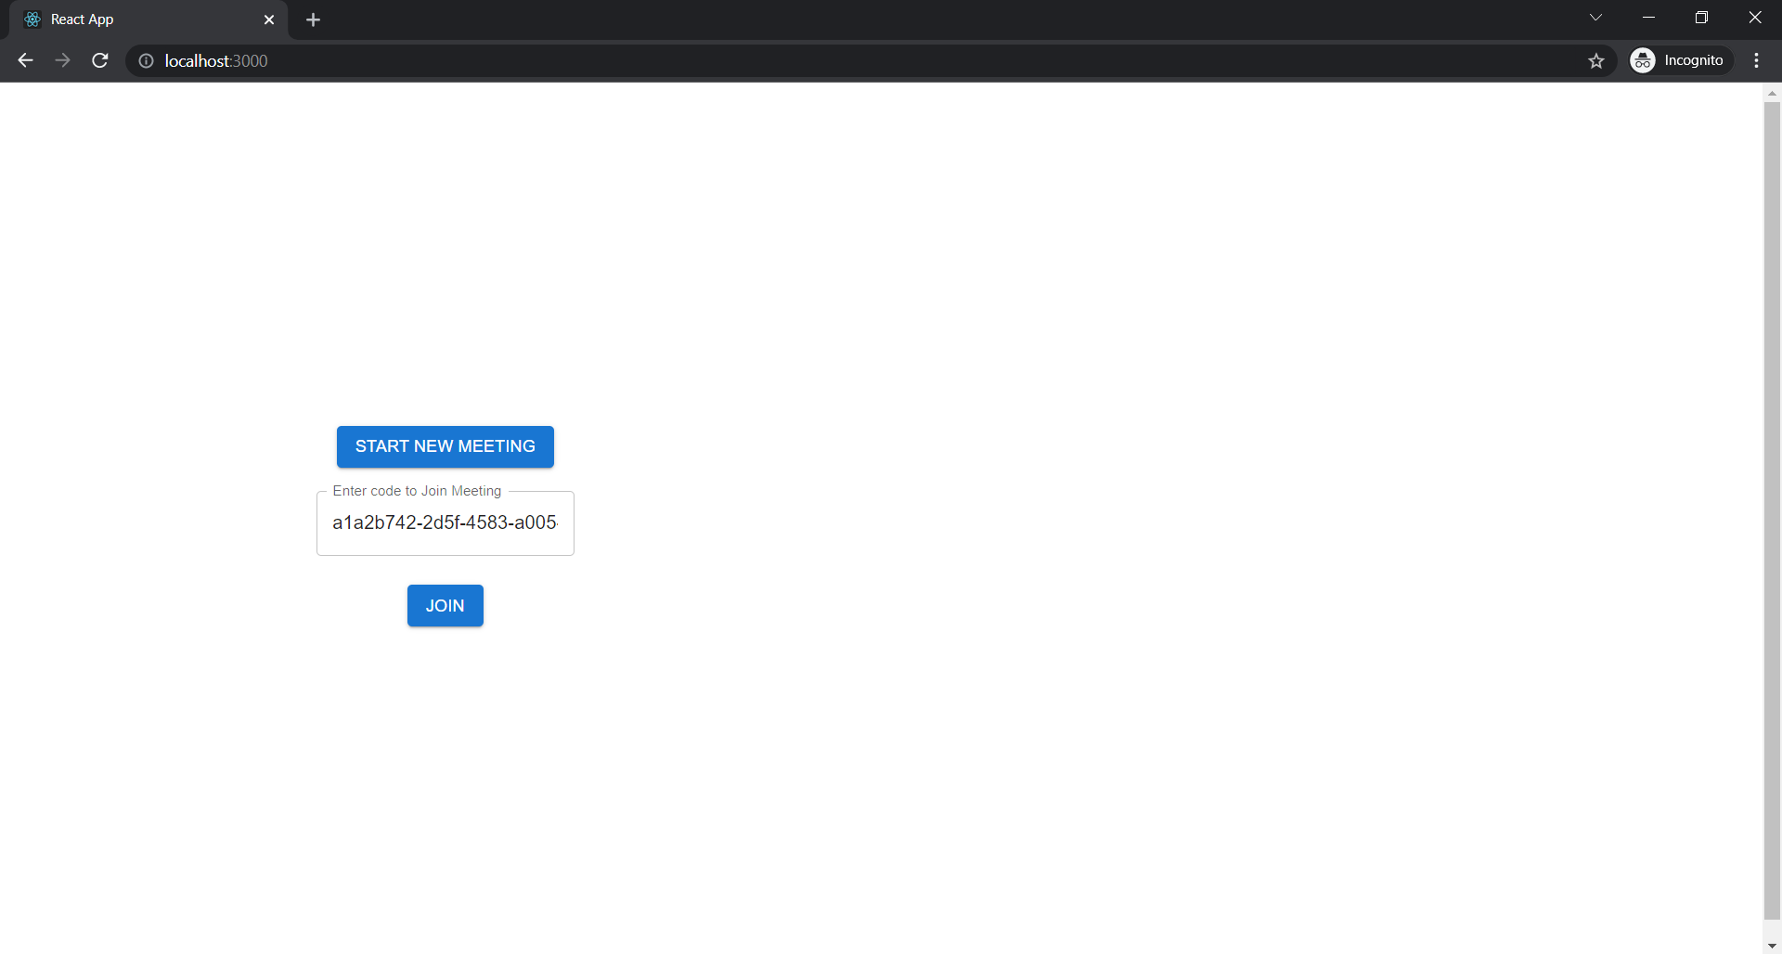
Click on START NEW MEETING button to generate new meeting code and then click on JOIN to join the meeting.
If you already have a code and want to join the meeting, directly enter the code in Input box and click on JOIN to join the meeting.

Slide 10
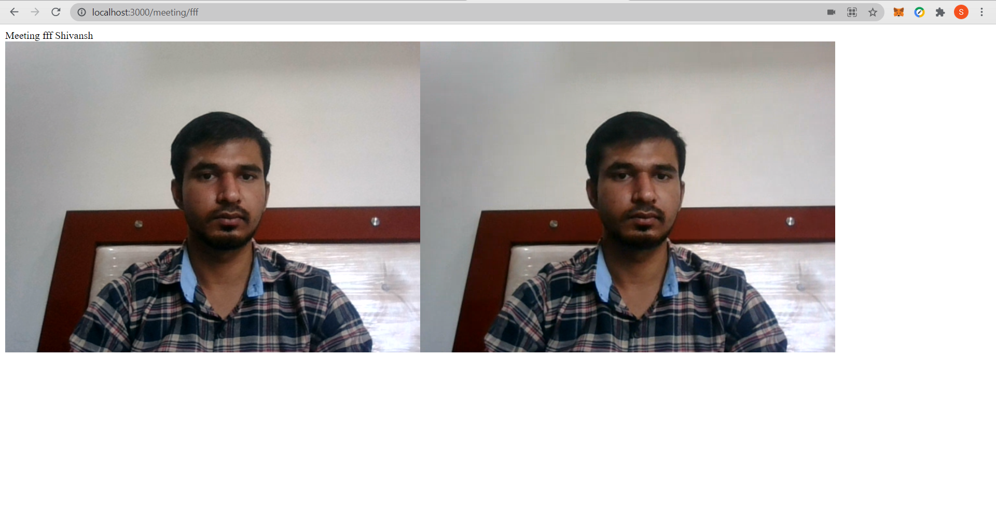
As the application is running on localhost so for testing purpose, we have joined the same meeting room from incognito tab, this is how it looks when 2 users join at the same time.

Slide 11
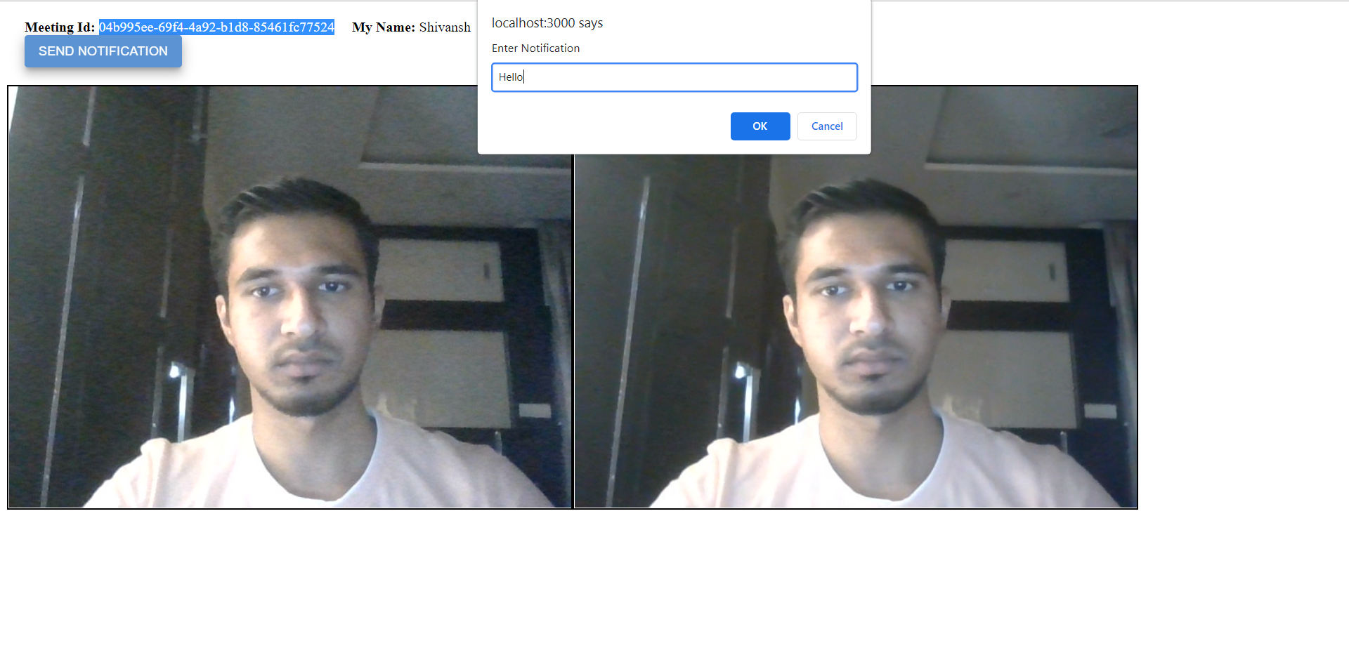
Click on Send Notification button to send notification to participants in the meeting.

Slide 12
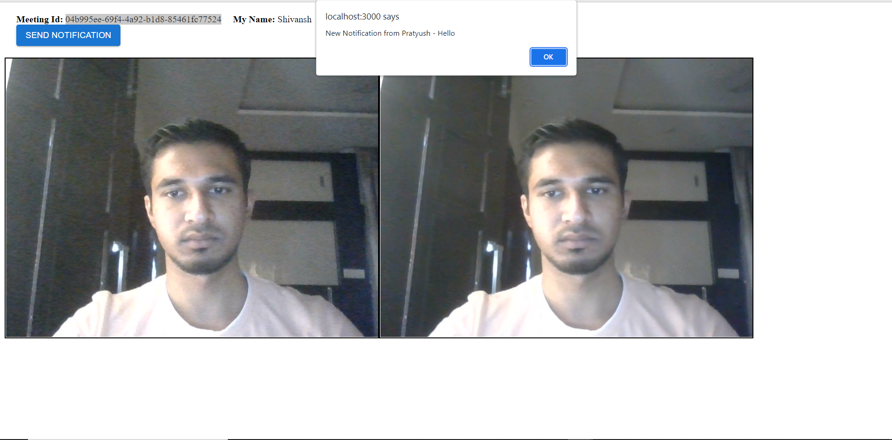
Notification received from a user to all the meeting participants.

Slide 13
Timeline
Research about required modules | Before Review 1
Implementation where users can join a meeting room or create a new URL for a video calling. | Before Review 2
Adding chatting feature in application during the meeting. | Before Review 3

Slide 14
Conclusion
By doing this project we learnt about how the real time peer to peer communication takes place through webRTC and how this technology has been the most essential tool during the time of covid , most companies such as zoom, google meet uses webRTC as their backbone via application interfaces to provide real time communication

Slide 15
References
https://webrtc.org/
https://socket.io/
https://nodejs.org/en/
https://expressjs.com/

Slide 16


Team Members

Slide 17
Thankyou

